Slide 1
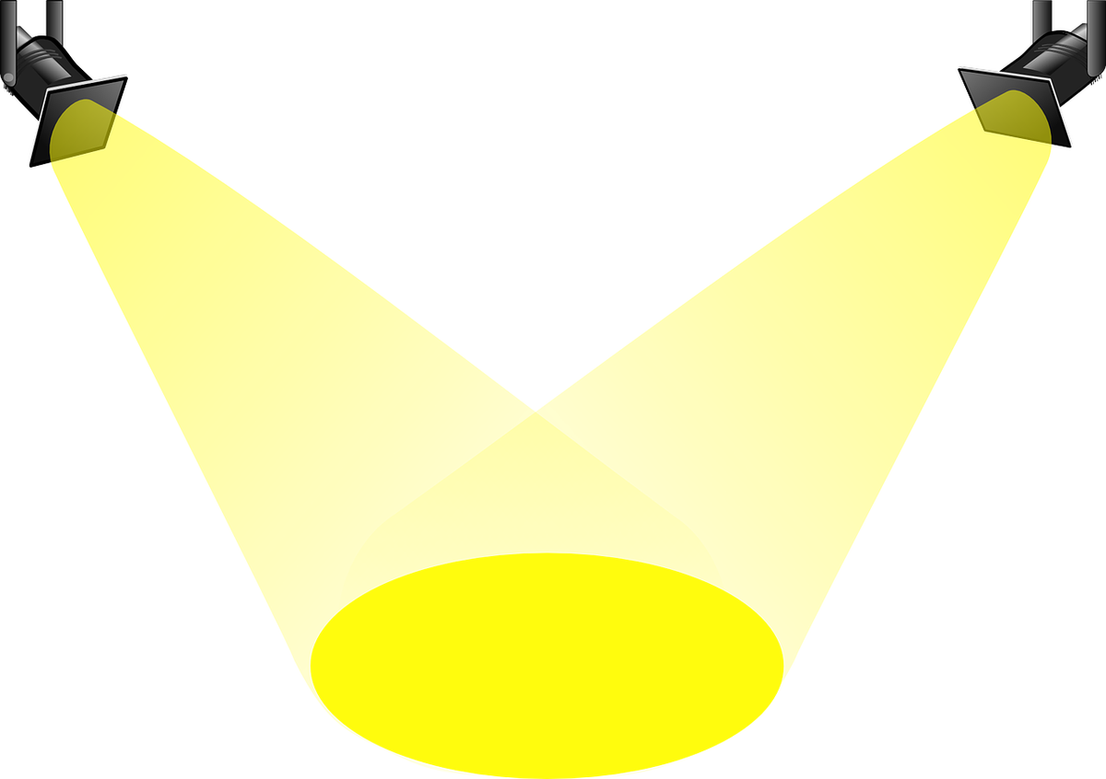
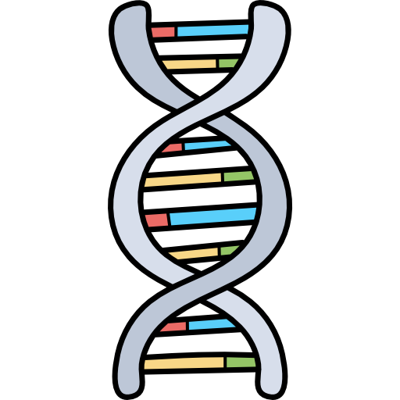
Do I really require an introduction? I made you guys :P

Slide 2
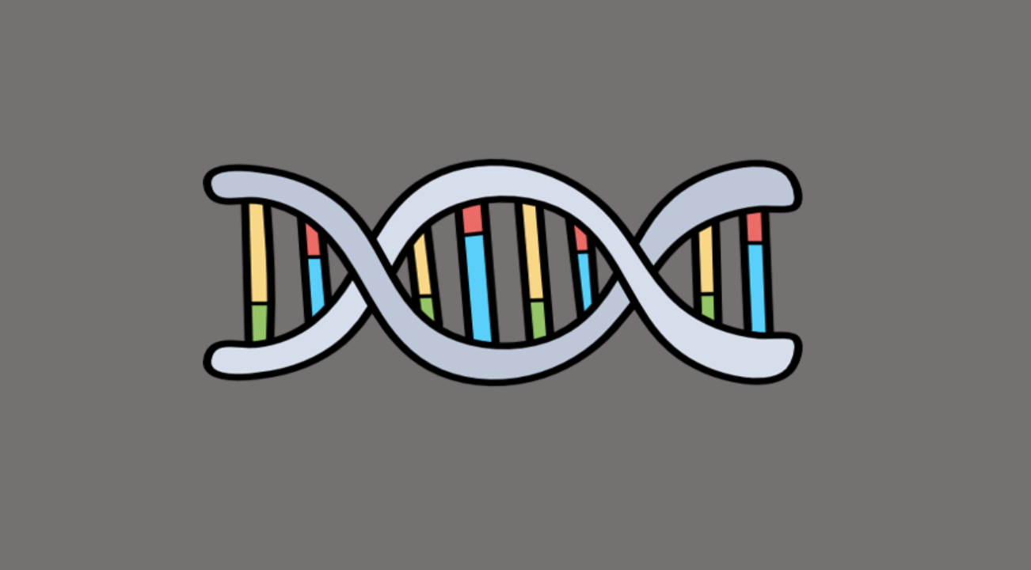

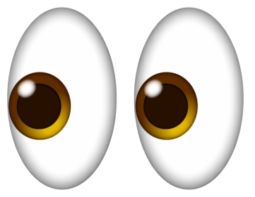


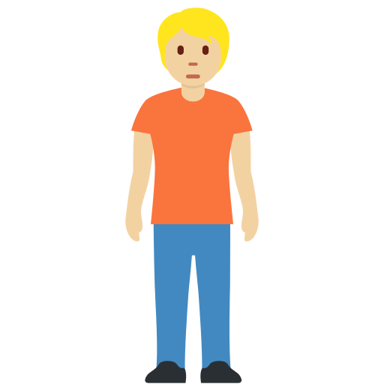
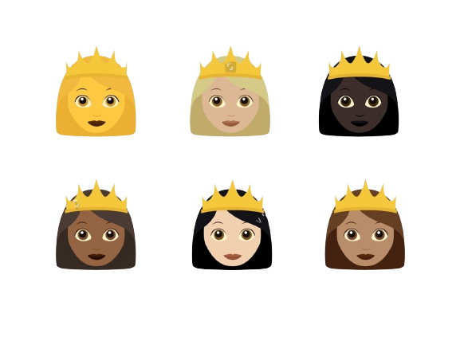
Double Helix
5’
3’
5’
3’

Slide 3



DNA
DNA
DeoxyriboNucleicAcid
Nitrogeneous Base
Phosphate
Sugar
T
G
A
C

Slide 4
Thymine
Adenine
Hydrogen Bonds
Cytosine
Guanine

Slide 5
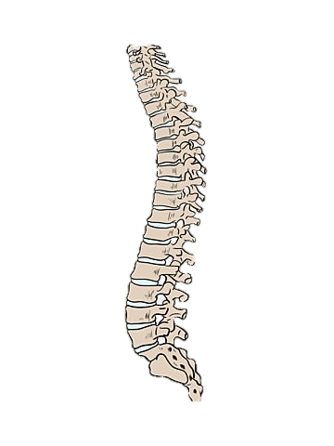
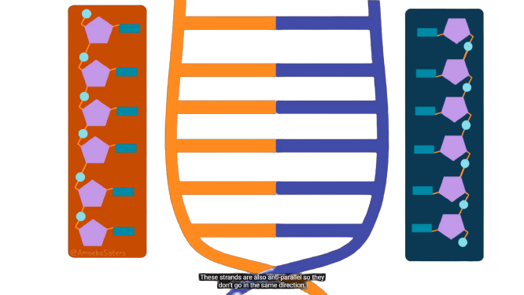
ANTIPARALLEL

Slide 6

Why?
DNA Replication?

Slide 7
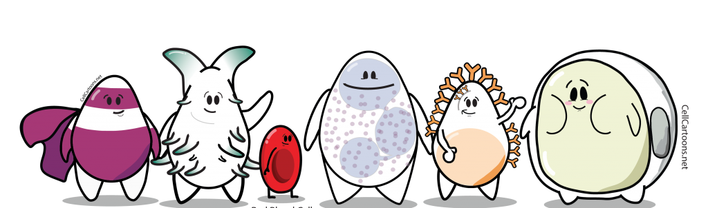

What do we do?
Shut up and concentrate!

Slide 8



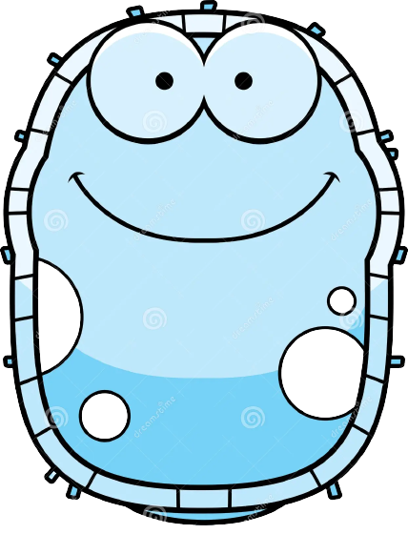

Growth
Where?
Repair
Regeneration

Slide 9
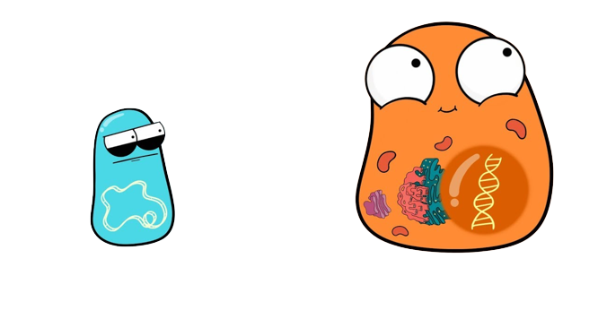
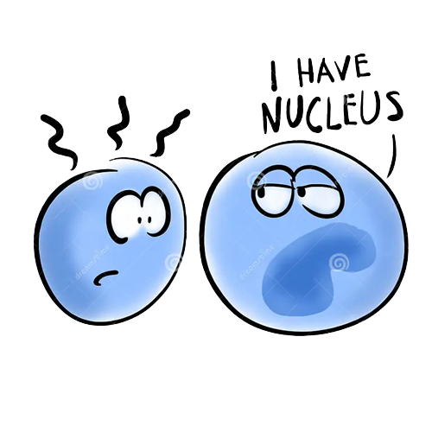
But How?
I am here too…in the cytoplasm…trust me :’)
Are you looking for me?

Slide 10
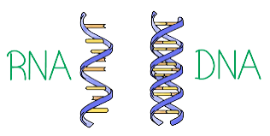
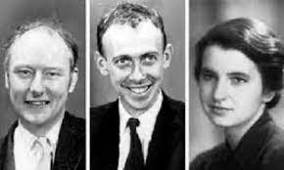

Picture!

Slide 12
Meselson & Stahl
Conservative
Semi-Conservative
Dispersive

Slide 13

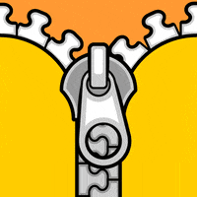
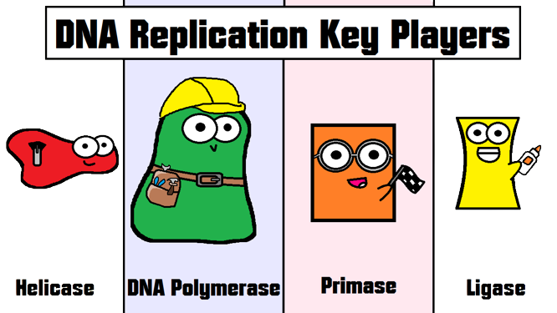
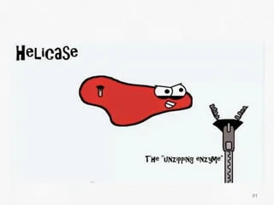
Origin Of Replication
3’
5’
5’
3’

Slide 14

SSB Proteins
3’
5’
Replication Bubble
5’
3’
DNA Gyrase
DNA Gyrase
SSB Proteins

Slide 15


Primase
DNA Polymerase
3’
Leading Strand
5’
5’
3’
5’
3’
3’
5’

Slide 16
3’
Leading Strand
5’
5’
3’
3’
3’
5’
3’
5’
3’
5’
Lagging Strand
Okazaki Fragments
Okazaki Fragments

Slide 17
3’
5’
5’
3’

Slide 18
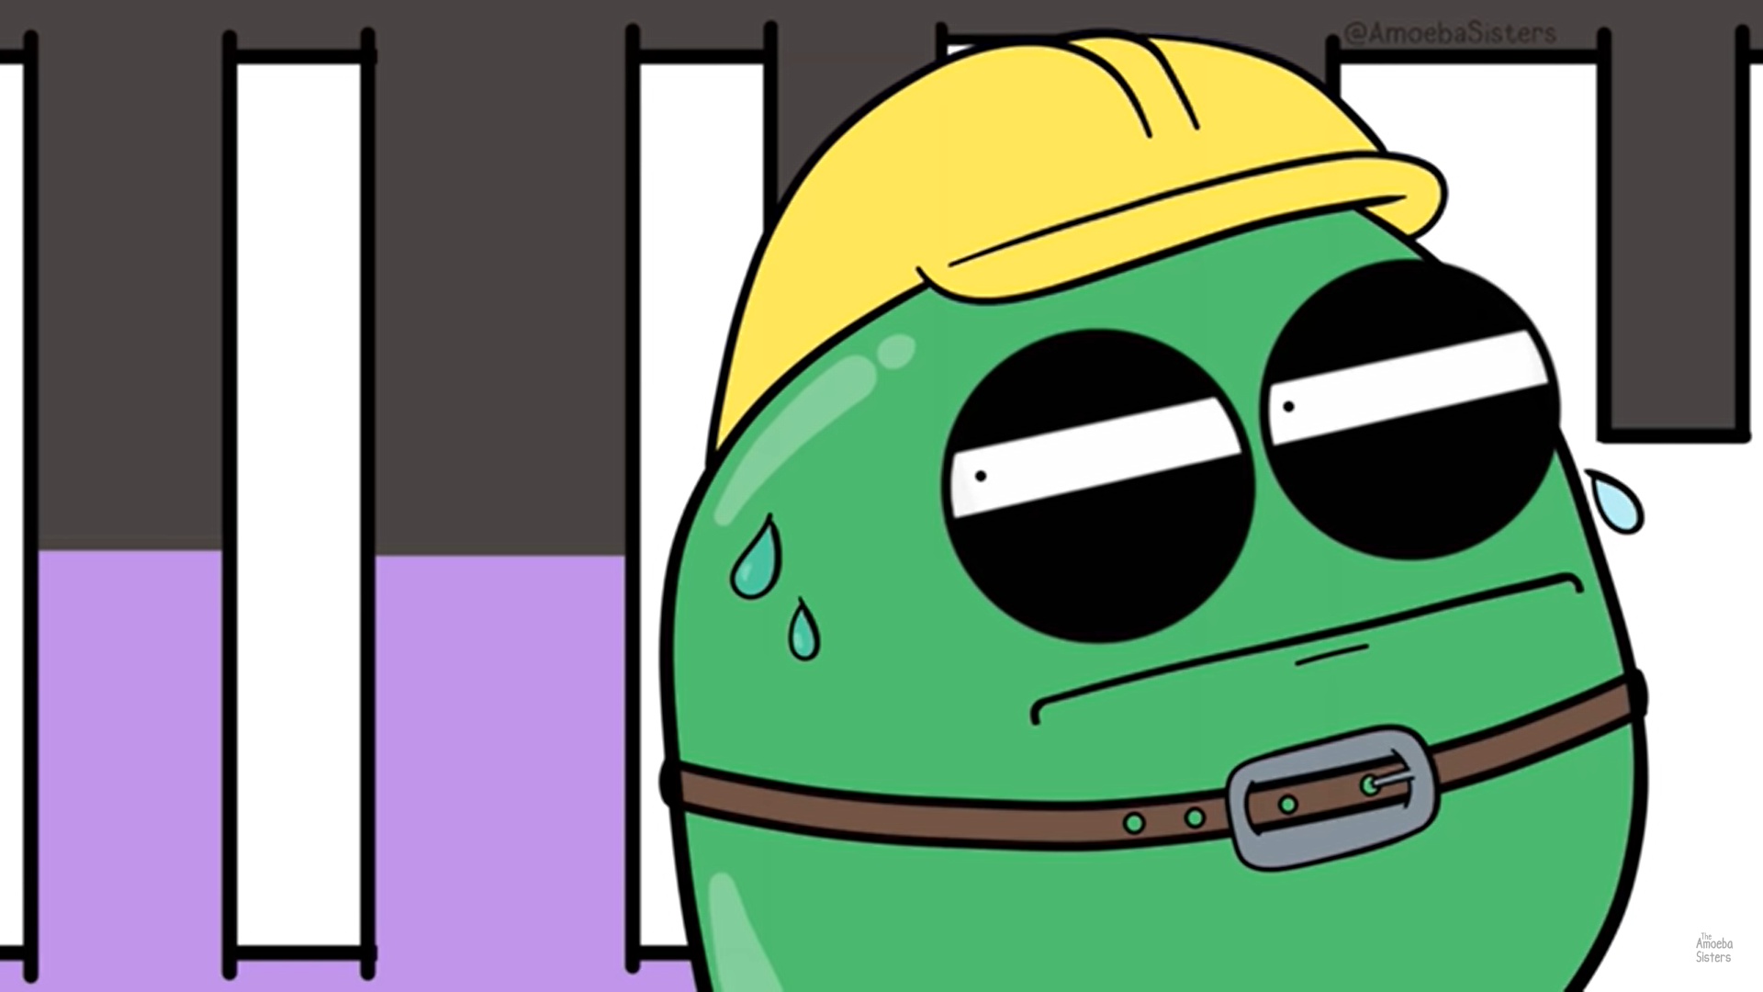
How?

Slide 19
Specific rich base pair sites
ATP : ADP ?

Slide 20
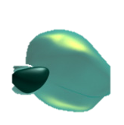
Hi…I am DNA Polymerase! Who are you?
Hi…I am RNA Polymerase!
1.DNA polymerase synthesizes DNA while RNA polymerase synthesizes RNA.
2.In contrast with the DNA polymerase, RNA polymerases do not necessarily require the so called primer to start the process and they actually have no proofreading systems.
3.RNA polymerases are capable of initiating a new strand but DNA polymerases cannot.
4.DNA contains the pentose sugar deoxyribose while RNA contains the pentose sugar ribose.
5.DNA polymerase will be continuous till the work is finally done wherein RNA polymerases will continue but eventually may break in the event it will reach a “stop” cycle.

